Slide 1
Data Communication and Computer Networks (CCE2102)
By: Dr. Lal Pratap Verma

Slide 2
Data Link Layer
Multiple Access
When a sender and receiver have a dedicated link to transmit data packets, the data link control is enough to handle the channel.
Suppose there is no dedicated path to communicate or transfer the data between two devices. In that case, multiple stations access the channel and simultaneously transmit the data over the channel.
It may create collision and cross-talk.
Hence, the multiple access protocols is required to reduce the collision and avoid crosstalk between the channels.

Slide 3
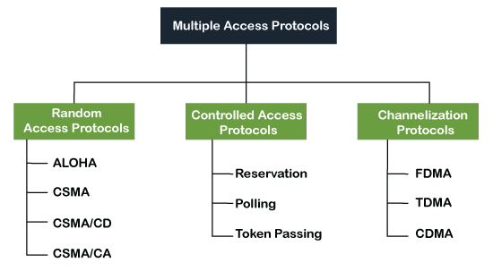
Data Link Layer
Multiple Access

Slide 4
Data Link Layer
Random Access Protocol
In this protocol, all the station has the equal priority to send the data over a channel.
In random access protocol, one or more stations cannot depend on another station nor any station control another station.
Depending on the channel's state (idle or busy), each station transmits the data frame. However, if more than one station sends the data over a channel, there may be a collision or data conflict.
Due to the collision, the data frame packets may be lost or changed. And hence, it does not receive by the receiver end.

Slide 5
Data Link Layer
Random Access Protocol
Following are the different methods of random-access protocols :
Aloha
CSMA
CSMA/CD
CSMA/CA

Slide 6
Data Link Layer
ALOHA Random Access Protocol
It is designed for wireless LAN (Local Area Network) but can also be used in a shared medium to transmit data.
By using this method, any station can transmit data across a network simultaneously when a data frameset is available for transmission.
Aloha Rules
Any station can transmit data to a channel at any time.
It does not require any carrier sensing.
Collision and data frames may be lost during the transmission of data through multiple stations.
Acknowledgment of the frames exists in Aloha. Hence, there is no collision detection.
It requires retransmission of data after some random amount of time.

Slide 7
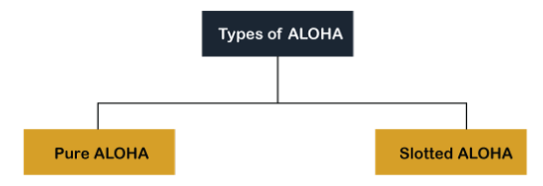
Data Link Layer
ALOHA Random Access Protocol

Slide 8
Data Link Layer
Pure Aloha
In pure Aloha, when each station transmits data to a channel without checking whether the channel is idle or not, the chances of collision may occur, and the data frame can be lost.
When any station transmits the data frame to a channel, the pure Aloha waits for the receiver's acknowledgment.
If it does not acknowledge the receiver end within the specified time, the station waits for a random amount of time, called the backoff time (Tb).
And the station may assume the frame has been lost or destroyed. Therefore, it retransmits the frame until all the data are successfully transmitted to the receiver.

Slide 9
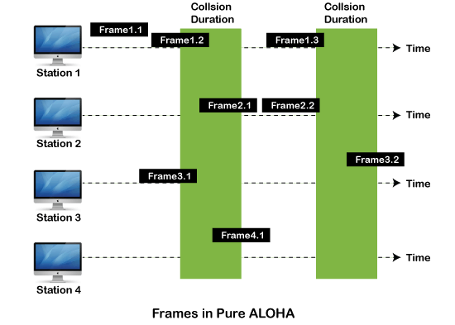
Data Link Layer
Pure Aloha
Notes:
As we can see in the figure above, there are four stations for accessing a shared channel and transmitting data frames. Some frames collide because most stations send their frames at the same time. Only two frames, frame 1.1 and frame 2.2, are successfully transmitted to the receiver end. At the same time, other frames are lost or destroyed. Whenever two frames fall on a shared channel simultaneously, collisions can occur, and both will suffer damage. If the new frame's first bit enters the channel before finishing the last bit of the second frame. Both frames are completely finished, and both stations must retransmit the data frame.

Slide 10
Data Link Layer
Slotted Aloha
The slotted Aloha is designed to overcome the pure Aloha's efficiency because pure Aloha has a very high possibility of frame hitting.
In slotted Aloha, the shared channel is divided into a fixed time interval called slots.
So that, if a station wants to send a frame to a shared channel, the frame can only be sent at the beginning of the slot, and only one frame is allowed to be sent to each slot.
And if the stations are unable to send data to the beginning of the slot, the station will have to wait until the beginning of the slot for the next time.
The possibility of a collision remains when trying to send a frame at the beginning of two or more station time slot.

Slide 11
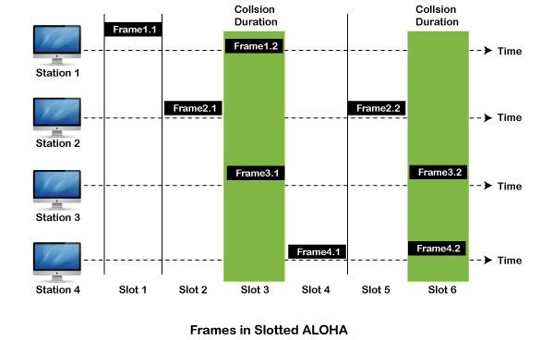
Data Link Layer
Slotted Aloha

Slide 12
Data Link Layer
CSMA (Carrier Sense Multiple Access)
It is a carrier sense multiple access based on media access protocol to sense the traffic on a channel (idle or busy) before transmitting the data.
It means that if the channel is idle, the station can send data to the channel. Otherwise, it must wait until the channel becomes idle.
Hence, it reduces the chances of a collision on a transmission medium.

Slide 13
Data Link Layer
CSMA Access Modes
1-Persistent: In the 1-Persistent mode of CSMA that defines each node, first sense the shared channel and if the channel is idle, it immediately sends the data.
Else it must wait and keep track of the status of the channel to be idle and broadcast the frame unconditionally as soon as the channel is idle.
Non-Persistent: It is the access mode of CSMA that defines before transmitting the data, each node must sense the channel, and if the channel is inactive, it immediately sends the data. Otherwise, the station must wait for a random time (not continuously), and when the channel is found to be idle, it transmits the frames.

Slide 14
Data Link Layer
CSMA Access Modes
P-Persistent: It is the combination of 1-Persistent and Non-persistent modes.
The P-Persistent mode defines that each node senses the channel, and if the channel is inactive, it sends a frame with a P probability. If the data is not transmitted, it waits for a (q = 1-p probability) random time and resumes the frame with the next time slot.

Slide 15
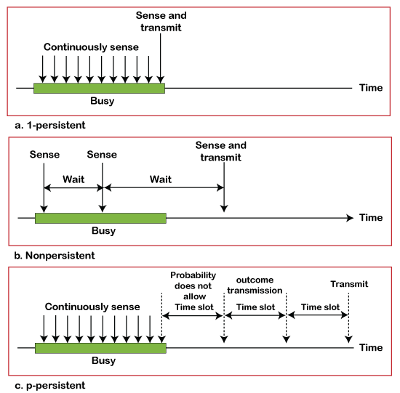
Data Link Layer
CSMA Access Modes

Slide 16
Data Link Layer
CSMA/ CD
It is a carrier sense multiple access/ collision detection network protocol to transmit data frames.
The CSMA/CD protocol works with a medium access control layer.
Therefore, it first senses the shared channel before broadcasting the frames, and if the channel is idle, it transmits a frame to check whether the transmission was successful.
If the frame is successfully received, the station sends another frame. If any collision is detected in the CSMA/CD, the station sends a jam/ stop signal to the shared channel to terminate data transmission. After that, it waits for a random time before sending a frame to a channel.

Slide 17
Data Link Layer
CSMA/ CA
It is a carrier sense multiple access/collision avoidance network protocol for carrier transmission of data frames.
It is a protocol that works with a medium access control layer. When a data frame is sent to a channel, it receives an acknowledgment to check whether the channel is clear.
If the station receives only a single (own) acknowledgment, that means the data frame has been successfully transmitted to the receiver.
But if it gets two signals, a collision of the frame occurs in the shared channel.

Slide 18
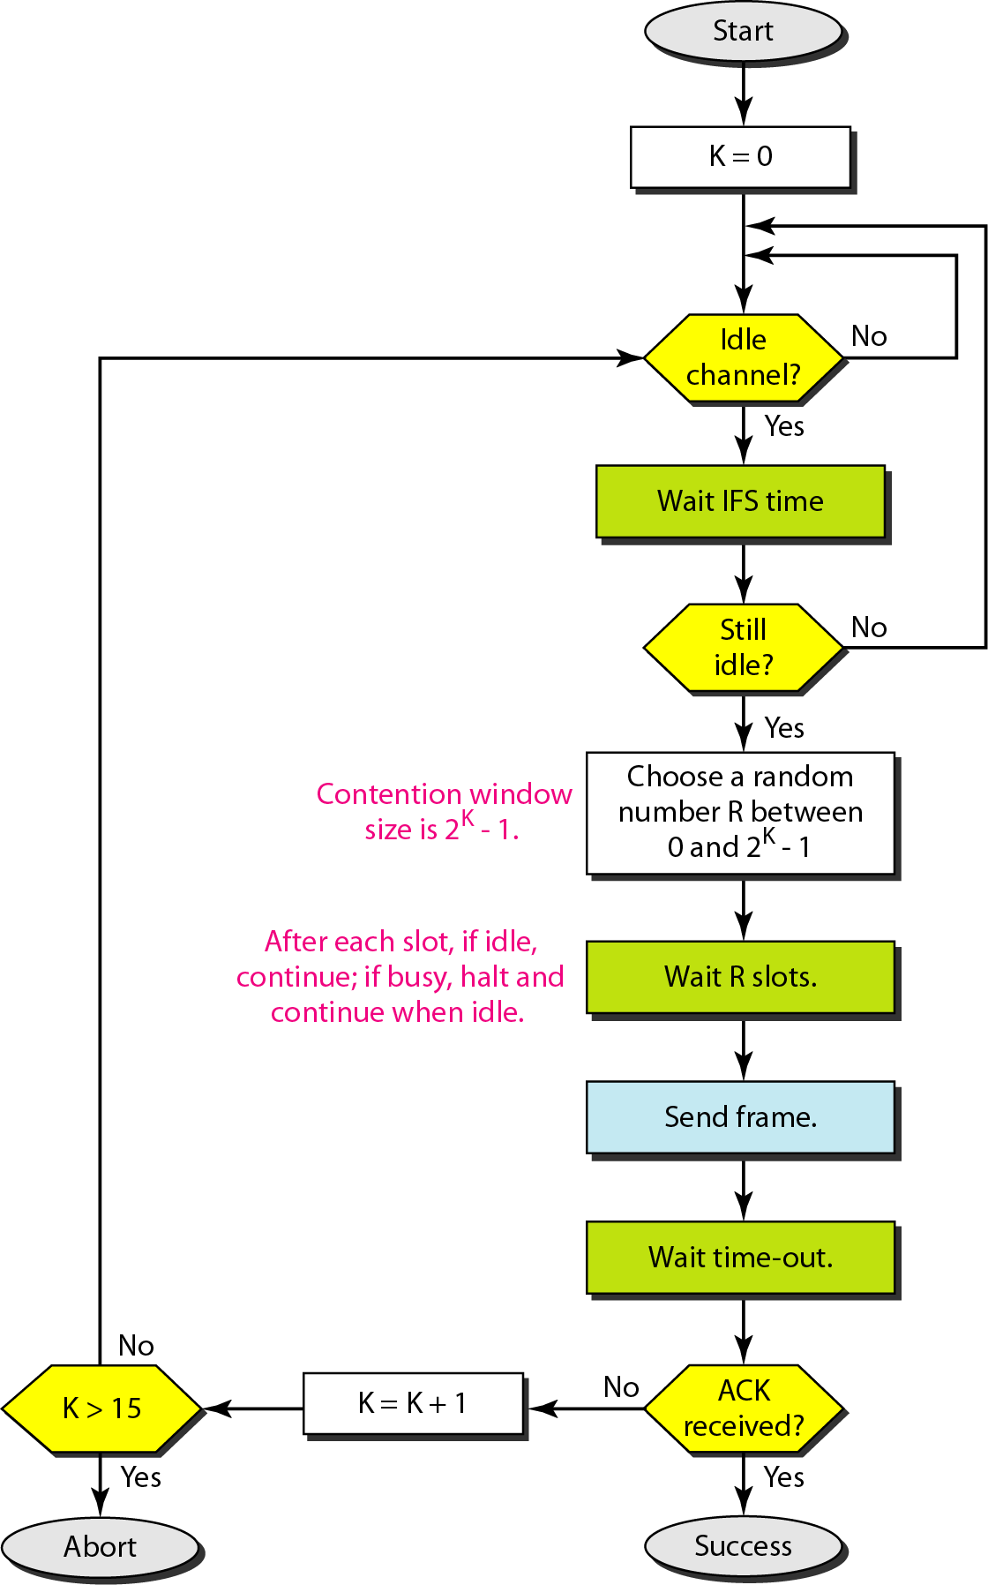
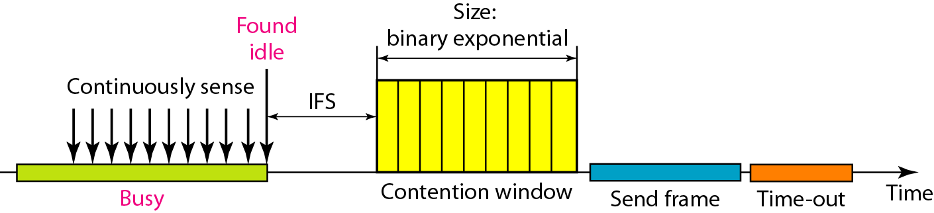
Data Link Layer
CSMA/ CA

Slide 19
References
W. Stallings, Data and Computer Communications, (10e), Pearson Education, 2014.
B. A. Forouzan, Data Communications & Networking, (5e), McGraw Hill, 2013.
D. P. Bertsekas, R. G. Gallager, Data Networks, (2e), Prentice Hall of India, 2011.
A. S. Tenenbaum, Computer Networks, (5e), Prentice Hall of India, 2008.
L. L. Peterson, B. S. Davie, Computer Networks: A Systems Approach, (5e), Morgan Kaufmann Publishers, 2011.

